Slide 1
Chiseldon Neighbourhood Development Plan
Chiseldon Vision
Chiseldon House, 13 December 2021
andrea@pellegram.co.uk

Slide 2
What is a Neighbourhood Plan?
In very simple terms, a neighbourhood plan is:
A document that sets out planning policies for the neighbourhood area – planning policies are used to decide whether to approve planning applications
Written by the local community, the people who know and love the area, rather than the Local Planning Authority
A powerful tool to ensure the community gets the right types of development, in the right place
Locality

Slide 3
Neighbourhood planning was introduced in the Localism Act 2011. It is an important and powerful tool that gives communities statutory powers to shape how their communities develop.
Locality

Slide 4
Benefits of NP
Should take precedence over all other policies
100% “legitimate” in the minds of all stakeholders
25% of CIL receipts towards local community infrastructure (15% if not)
Government is giving clear messages that they are here to stay

Slide 5
But, neighbourhood plans are only as good as the policies they contain!
NDP’s can be “made” and still be ignored when decisions are taken.
It is important to do them correctly.

Slide 6
What can an NDP achieve?
Add detail to existing and emerging local plan policy
Alert developers to the needs of the local community so that you negotiate more successfully
Help your parish council prioritise its infrastructure spending

Slide 7
What can it NOT do?
Prevent allocated development (especially housing) from proceeding
Change or conflict with higher tier policies
Deal with anything that is not material to the planning system
Over-ride the powers of statutory undertakers

Slide 8
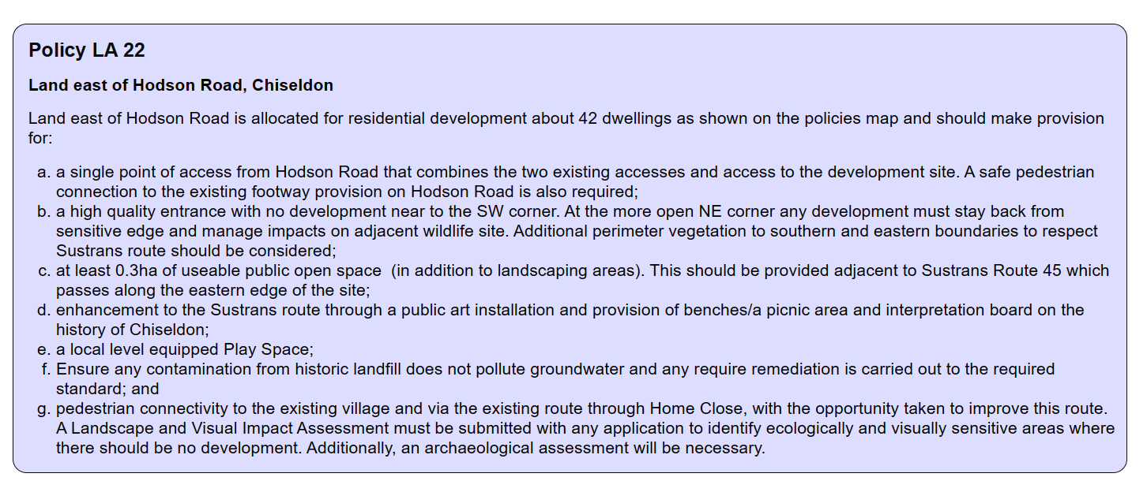
Draft Local Plan Review 2036

Slide 9
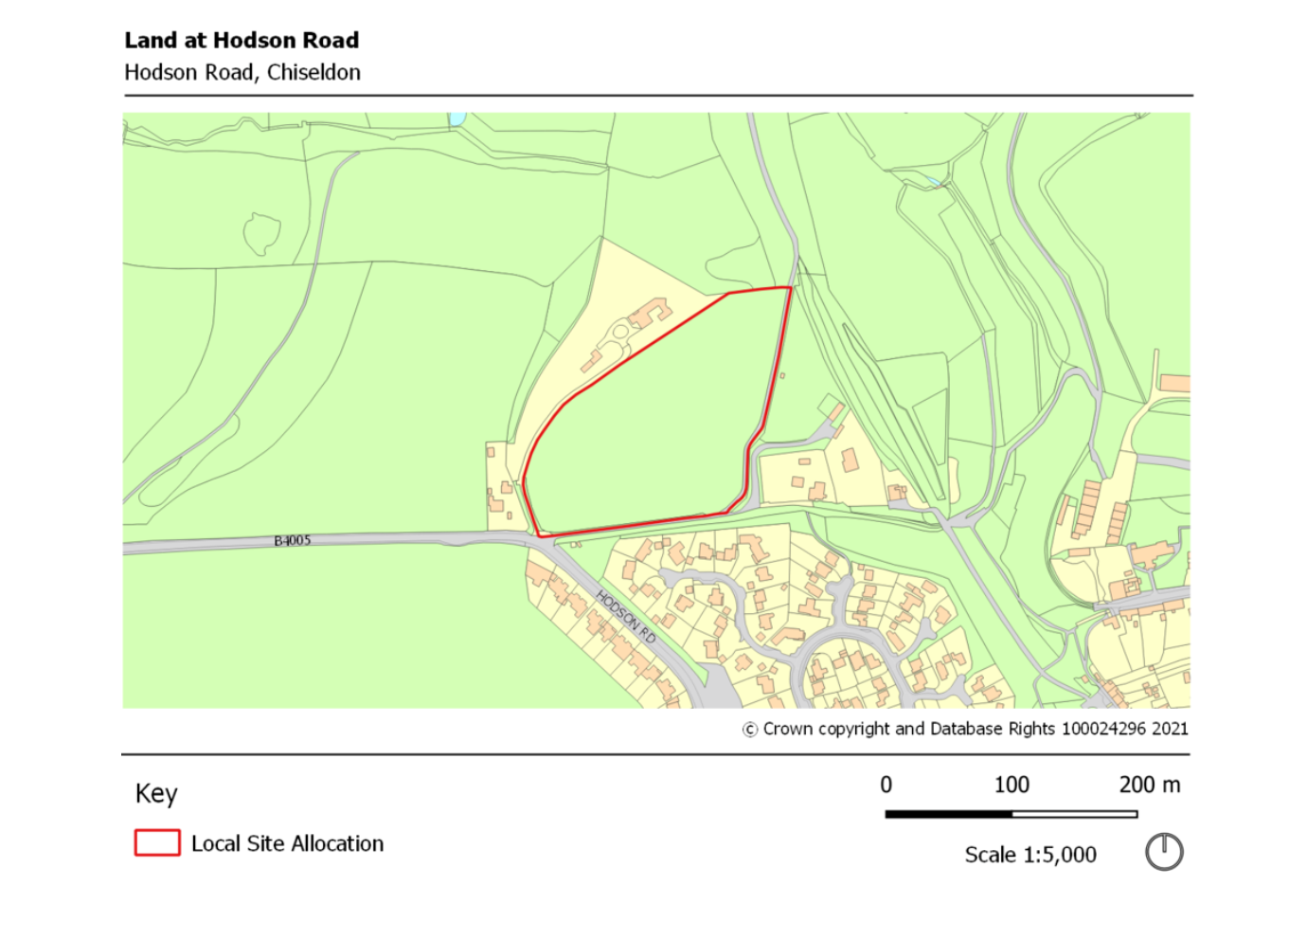
Draft Local Plan Review 2036

Slide 10
Masterplan policy?
Masterplan policy for Hodson Road
  Map out walking and cycling routes (including Sustrans route) to rest of settlement and other villages
  Inter-relationship with wildlife site and set out required biodiversity net gain
  Design/focus of public open space, picnic area, etc.
  Specification of public art

Slide 11
Developer contributions
Set out clear developer contributions so that development delivers completely and on time

Slide 12
Sustainable development and design
Design policy to ensure new development is in keeping with existing character
Seek to ensure that new development meets expectations of climate emergency

Slide 13
Sustainable transport
Footway and cycle way improvements
Signage improvements and way marking
Where possible, manage impacts from A436

Slide 14
Local Green Spaces
Identify and protect local green spaces from development pressure
  Playing fields
  Recreation ground
  Smaller green spaces

Slide 15
Biodiversity and the natural environment
Identify wildlife corridors
Set out how biodiversity net gain should be delivered
Identify any special species or features that require special attention

Slide 16
Any questions?

Slide 17
What do you think?

Slide 18
SWOT exercise
Strengths
Weaknesses
Opportunities
Threats

Slide 19
Vision to 2031?
How would you like to see this all develop by 2036?

Slide 20
Policies
What policies would you
like to see in the NDP?

Slide 21


Dr Andrea Pellegram, MRTPI
andrea@pellegram.co.uk

