Slide 1
Chiseldon Parish Council Annual Parish Meeting
Monday 12th April 2021 6.30pm via MS Teams

Slide 2
Chairman’s welcome
Cllr Matt Harris

Slide 3
Penny Marno, Consultant in Public Health. Swindon Borough Council
Covid 19 response 2020 and 2021

Slide 4
Covid in Swindon (as at 11th April)
Total Cases 11326

Slide 5
A toolkit of intervention

Slide 6
Testing
2 main types:
Symptomatic
Asymptomatic
Sites around Swindon
New initiative: Rapid testing for all
Home kits
Collect from test sites
Pharmacy collect
LFTs
Results back quickly
PCR confirmation if positive
Recommended twice a week
Vaccination
NHS Led
Over 500,000 people vaccinated across BSW; over 85% of cohorts 1-9
Available at Steam, GWH, pharmacies in Swindon
NHS are working through cohorts 10-12 over coming weeks / months
If you have concerns look at reliable sources of information (e.g. Q&A on CCG website and NHS)
Even if you have been vaccinated if you get symptoms you still need to get tested and self isolate
Even if you have been vaccinated you still need to remember ‘face, hands, distance, ventilation’
Roadmap
12th April
17th May
21st June…
Information
covidresponse@swindon.gov.uk
https://www.swindon.gov.uk/coronavirus/

Slide 7
Annual report from Chiseldon Tennis Club
From Julie Porte, Club Chairman

Slide 8
Chiseldon Tennis Club Report for Parish Council - April 2021
Our tennis year begins in April and as tennis courts opened last year gradually in May after lockdown we were pleased to welcome back our members, invite new members and eventually start up Pay & Play again.
The clubhouse has been out of bounds except for toilet facilities and there have been no social events but we did play a bit of Winter league tennis before we were closed down again.
Our club is small but has grown and thrived in spite of Covid. We are a mixed ability bunch, playing in top leagues and also mid leagues and we are friendly and welcoming.
Phil our coach left to go back into financial services in July and we warmly welcomed our new head coach - Lauren Prince. Lauren coaches children on Wednesdays, Fridays and Saturdays at the moment and runs holiday clubs which she advertises on Facebook.
LTA Youth Start - is a brand new course from the LTA that offers children a 6 week coaching course, a tennis racket, set of balls and a t-shirt - Lauren is running a couple of courses details on Facebook and our website. laurenprince92@outlook.com 07931 308269
Lauren also runs courses for adults, does a great Cardio Tennis session on a Friday morning and does 1:1 coaching for members and non members.
She is also making contact with local schools.
We would welcome anyone to our club sessions to ‘try us out’ these are Wednesdays from 6.30 And Sunday mornings from 10.30.
Details of Chiseldon Tennis Club are on our website - www.chiseldontennisclub.co.uk or from info@chiseldontennisclub.co.uk
CTC Chair: Julie Porte 0775319995

Slide 9
Annual report from Chiseldon Gardening & Countryside club
From Wendy Forster, Club member

Slide 10
The Chiseldon Gardening & Countryside Club has happily worked with the Chiseldon Parish Council on three projects over the past year.
In March 2020. The Meadow Project was started at the back of the grass verge along New Road
The turf was cut by Peter Bracey then 10 club members turned the sods over before seeding the area with an assortment of meadow flowers. Covid-19 restricted movement & lack of water damaged this project. Later in the summer there were a few little patches of colour. Most noticeably two species of Clarkia, Californian poppy, and Calendula. The club plans to plant up plugs of Californian poppy, Godetia, columbine and a few other species.
The Wildflower Project is still in its early stages and this is located on the lower left of Stroud’s Hill green. In 2020, after one initial mow, the area was left to grow naturally to see what would flower. Although grasses predominated, there were a few interesting species but, more importantly, it was very evident that a wide range of insects really did benefit. This spring, 2 members planted out cowslips & forget-me-nots as well as sowing a mix of wildflowers to include field daisies, red poppies, & cornflowers.
Most recently the Millennium Copse. This came about following the major repair work carried out by SSE when a large area was left barren The club and parish council worked together to see the area planted with bluebells and a selection of shrubs to benefit wildlife as well as to look attractive. Towards the end of November, three club members and Clair planted out 1,000 bluebell bulbs after Karen had kindly brought up her rotavator to break up the ground. In December 45 purchased bareroot shrubs as well as a dozen wild shrubs which had been donated by club member Lynne together with Pheasant Berry shrubs and Carex plants donated by Tony and his wife were planted. Most of the shrubs are breaking nicely and the bluebell leaves are peeping through.

Slide 11
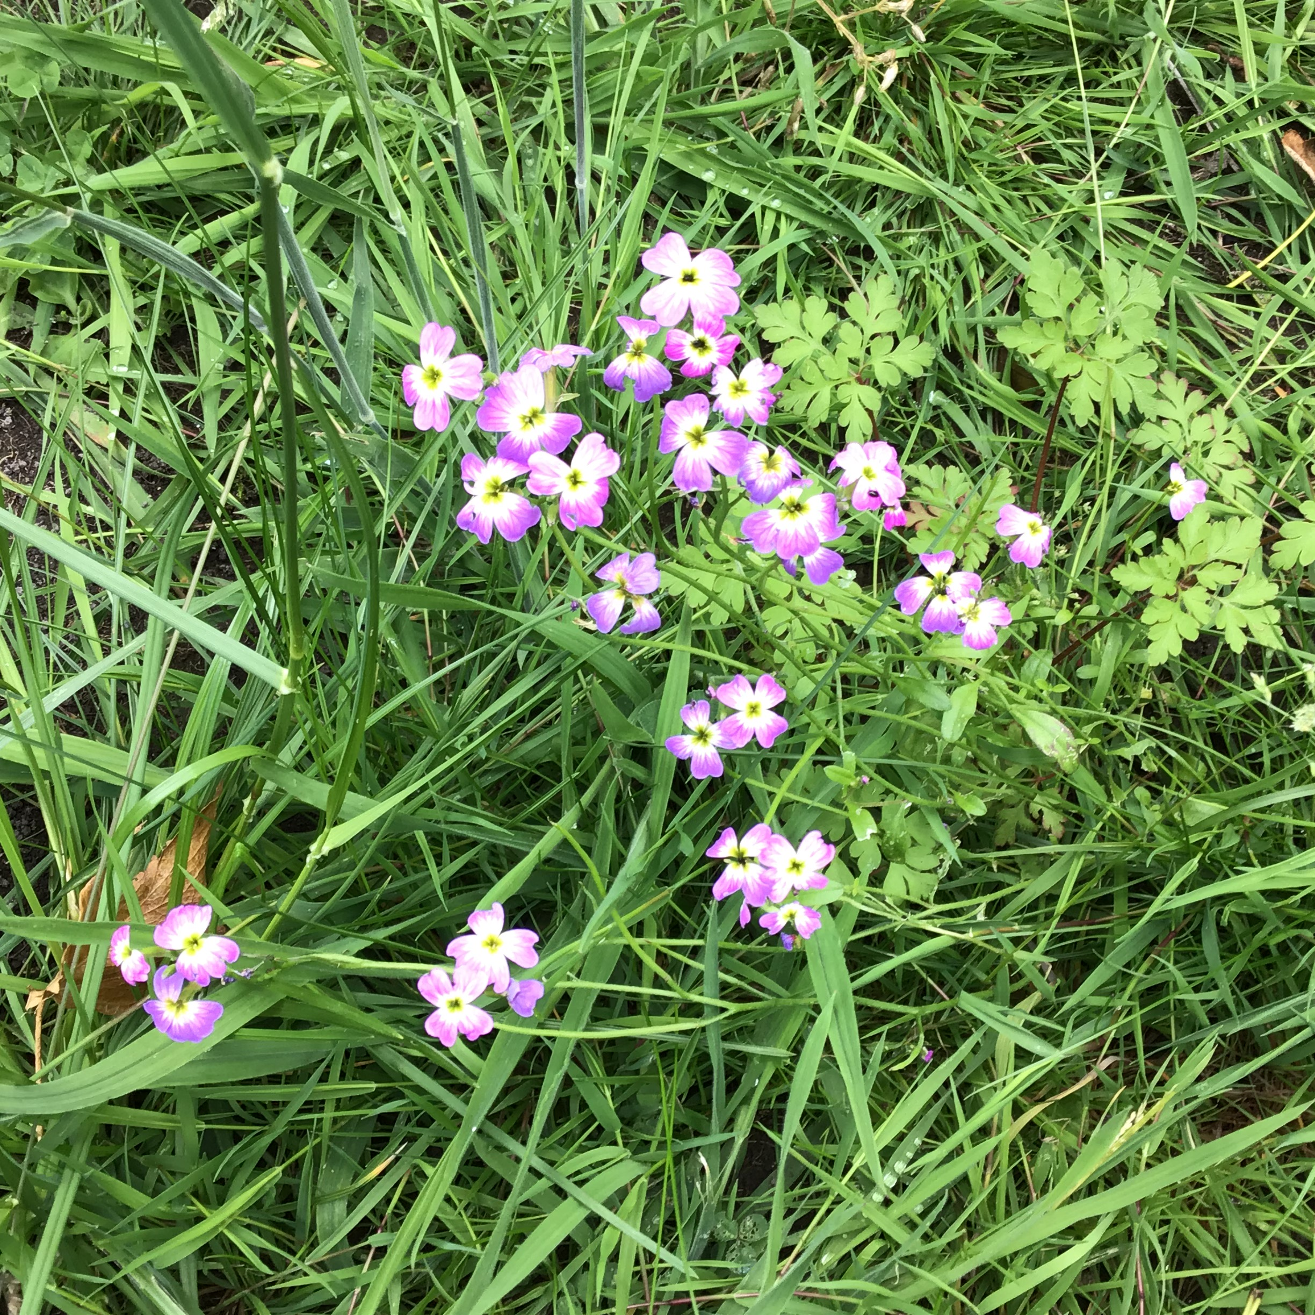
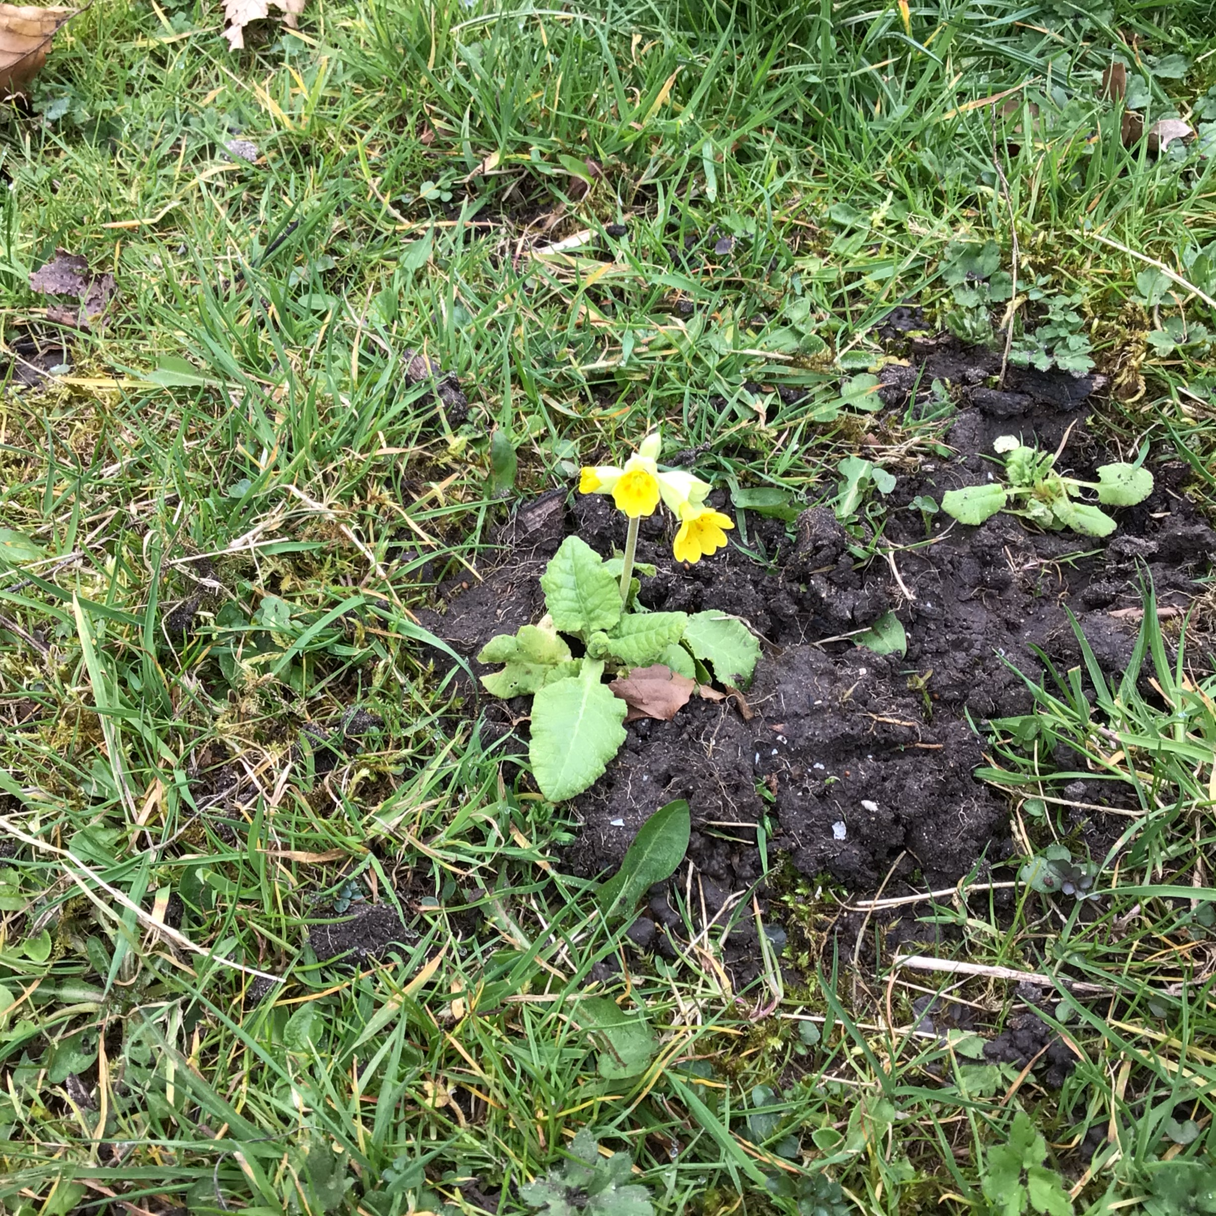
Finally, the Chiseldon Gardening & Countryside Club would like to invite anyone who would like information or be interested in joining the club. Contact details on full presentation. You don’t have to be a gardening expert to belong as most of our members just enjoy their gardens and see the evening as a social event. The club plan to hold meetings, when permitted, at 7:30 pm on the second Wednesday of each month in the Holy Cross Church Hall.
Dogwood
Cowslip

Slide 12
Annual report from Washpool Area Restoration Project (WARP)
From Hilary Howe, Club Chairman

Slide 13
With the announcement of the first Covid 19 Lockdown our regular volunteer days had to be halted. However we still had sheep huts renovated, tree defences erected and an electric fence installed around the pond on the island. This fence was required as a term of the funding granted by FWAG (Farming and Wildlife Advisory Group) who were tasked with providing suitable habitat for great crested newts. The newts like to have tall vegetation around their breeding ponds so we need to prevent sheep grazing too close to it.
We are very grateful to the Parish Council for the continued funding for contractors to carry out regular maintenance work. The contractors continued to work and so overall the site has been kept looking neat and tidy.
The Washpool has become increasingly popular during the pandemic with an observable rise in visitors. We have noticed that there are many new visitors from outside the village. They have been very complementary, expressing surprise and delight at finding such a delightful spot. The presence of our friendly sheep has made it particularly attractive to young families.
The two stretches of boardwalk in the main part of Washpool are showing signs of age and we had been advised that they wouldn't last another season. We decided we would like to replace them with banked up paths so as not to have the problem reoccur. This proved to be a cheaper option than replacing with new boardwalk but was still prohibitively expensive. Happily we have managed to secure the necessary funding from the Wiltshire community fund (thanks Clair for identifying this grant for us). We are awaiting a date from Adam Webb (THWC Group) as to when he can start work on this project.
If this sounds a little too energetic but you would still like to support us, we have Friends of Washpool. For this you pay an annual subscription of £5 for an individual or £10 for couples and families. In return for this you will be invited to special events arranged from time to time throughout the year. We use the funds generated by Friends of Washpool to pay for small projects and expenses such as plants, seeds and items for the sheep.

Slide 14
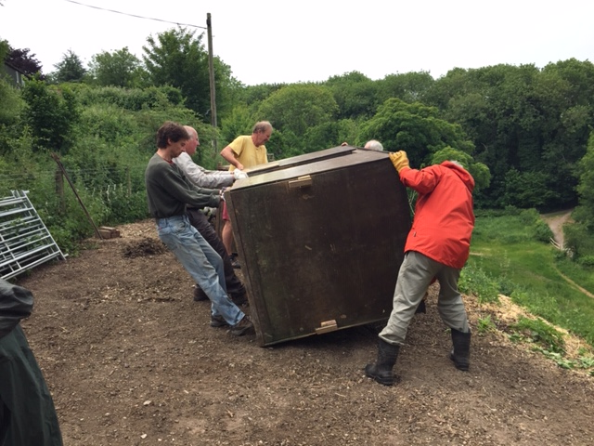
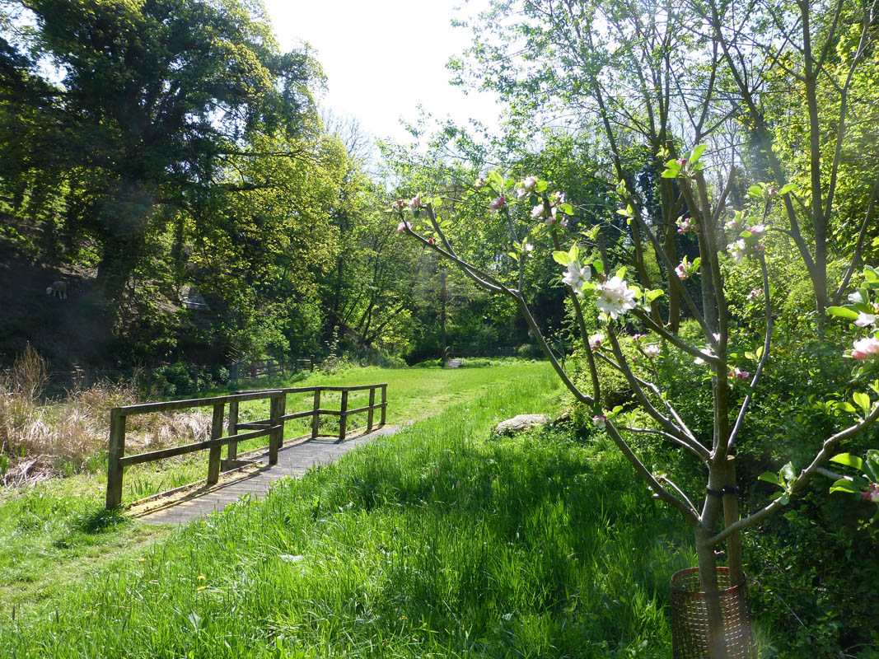
The grant will cover replacing the boardwalk, as well as funding some direction signs to Washpool, updating of our leaflet and the installation of a pipe to divert a small amount of water from the stream to the lower pond in the hopes of making it hold water a little longer in the season; thus creating a dipping pond for children. It also provides some money for repairs to the main track into Washpool which suffers damage from runoff from the main track in heavy rain. This is being discussed further after Thames Water’s heavy use of water recently at the site has made the track worse.
We are always on the lookout for new volunteers to come and join us helping to keep Washpool looking lovely. All being well we will soon be able to re-establish our regular Volunteer Days, usually on the 3rd Sunday in the months of January, March, May, July, September, and November. It is a very social occasion with tea, coffee and homemade cakes provided to power the work.
Some but by no means all the work is physically challenging and we try our best to find something to suit everyone's ability. We normally work from 10.00am until 2.30pm. Even if you can only spare the odd hour we will still be pleased to see you.
If you are interested please send an email to washpool@gmail.com and we will get in touch with details of our next Volunteer day or for a Friends of Washpool form.
New sheep house
Washpool this spring

Slide 15
Annual report from Chiseldon Local History Group
From Elaine Jones, Group Chairman

Slide 16
Like every organisation our activities this year have been limited by the pandemic.
Our monthly study meetings ceased; however, we are hopeful that most of the speakers we had booked for last year will still be available in 2021. We were unable to open the museum and it remains unclear when we will be able to do this. Hopefully this will be sometime late this summer.
The committee has kept in touch and even had some meetings in a garden and Chiseldon House Hotel when restrictions allowed. This meant we could continue work on the second interpretation Board in Church Street. With invaluable help from the Clerk around planning issues, and Sam Smith who did the Graphic design, this project is now nearing completion.
In October, the first interpretation board in Stroud’s Hill was indeed vandalised but repaired swiftly, thanks to a local metalworker and a kind donation from one of our members.
We took up the suggestion (Sam Smith again) to produce a calendar in time for Christmas and this was a great success. Many thanks to Dawn and team at Oakley’s Spar for selling them for us. We made over £300 which compensated for lack of income from membership fees this year.
The issue of the location of the Chiseldon Camp Commemorative Stone came to a head in November and it was deemed necessary to remove the stone to a place of safety. A local resident borrowed a JCB and it was transported without problems to a temporary home nearby. We still hope to find out who owns the land in front of the Test Centre in Ladysmith Road and get permission to place it there.
We owe a huge debt to the Parish Council, particularly The Clerk, for their tireless work in trying to resolve this intractable problem. Thanks also to Matty Frost, an artist with a JCB, and Neil Archer for providing a temporary home for the stone.

Slide 17
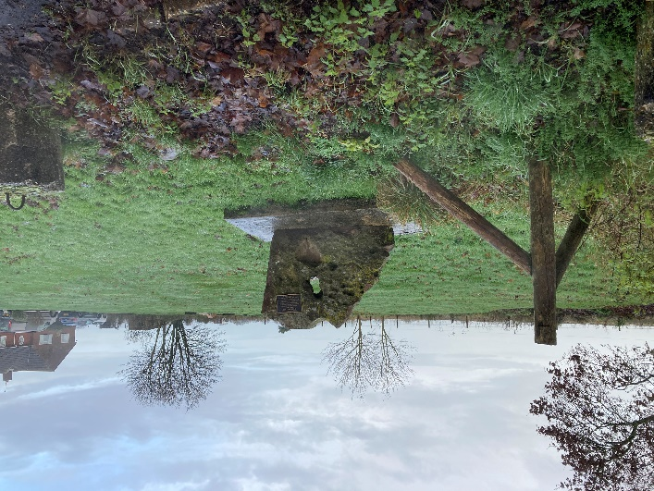
The future
CLHG is not short of ideas for future projects We have considered a series of essays on aspects of Chiseldon’s history; a history of Burderop Park; the Golf Course; walks around Chiseldon; and permanent displays for the museum about the Camp and the Railway (like the very successful Timeline.)
However, we are concerned that only a very small number of members is involved in this work. Although we have several volunteers to act as stewards in the museum during opening hours, only two of us are involved in creating displays and this is clearly not sustainable.
The committee works hard but some of us are feeling our age and we lack some expertise, especially in IT. Our website is not working properly and is something we would like to develop more as a way of fulfilling our core purpose; researching and sharing knowledge about Chiseldon’s history. We would welcome help with this.
Over the years we have accumulated a considerable archive of photographs, documents, publications, newspaper cuttings, maps, and artefacts, most of which have been catalogued. Only some of these can be stored and displayed in the museum as the environment is damp and dusty. As a result, committee members have an increasing accumulation in their cupboards. This is not an ideal situation.
Current Camp Memorial Stone location

Slide 18
Finance, Contracts and HR Committee report
Cllr Matt Harris, Committee Chairman

Slide 19
Highlights of the past year:
Spending in line with expectations
2.88% precept increase, from £139,000 to £143,000
Outside gym and new playground equipment
Grants and donations provided
Recreation hall to be tackled
Moving to Internet banking with Unity

Slide 20
Environment, General Purpose & Amenities Committee report
Cllr Chris Rawlings, Committee Chairman

Slide 21
Highlights of the Past Year
Washpool lease extension requested to 25 years
Approval of wildflower project
Tennis Club flood barrier
Allotment maintenance, improvements & tree work
Chiseldon Funday approved
Talks with Swindon Town Ladies Football Club
Outside gym and new play equipment
Planting, bulbs and seating at Millennium Copse
Ongoing tree inspections and safety work
Work approved for Chapel pathway and drainage
BIOS Youth Service ended. New provision to be investigated

Slide 22
Planning, Highways and Transport Development Committee report
Cllr Ian Kearsey, Committee Chairman

Slide 23
Highlights of the past year
Over 30 planning applications discussed and voted on
Investigating Neighbourhood Plan
Communicating with SBC over Earthline ongoing issues
Speed limit reduction at Draycot Foliat
Survey and ongoing investigations into New Road build out
Solar lighting at Draycot Foliat
Trying to progress plans for layby parking at Draycot Foliat and Windmill Piece

Slide 24
Chairman’s Annual report
Cllr Matt Harris, Council Chairman

Slide 25
Highlights of the past year
Thanks to Clair and Nina for their Covid19 parish work with food boxes and help for residents.
5 new Councillors Co-opted and one resignation
Planning, Highways and Transport Committee re-formed
Finance, Contracts and HR Committee re-formed
Sad news of the loss of our friends and colleagues
Moving into 2021/22

Slide 26
Public Q&A session – to close by 7.30pm
Chaired by Cllr Matt Harris

Slide 27
Thank you for joining us.
This presentation and more detailed reports can be viewed on our website www.Chiseldon-pc.gov.uk or on our Facebook Page “Chiseldon Parish Council Notices”, or by request from the Parish Clerk – clerk@chiseldon-pc.gov.uk.

